Slide 1
Advanced ADAS Features & AI Integrations

Slide 2

Agenda
01
Advanced ADAS Functionalities
02
Integration of AI & ML in ADAS
03
Challenges in AI Integration & Performance Optimization

Slide 3

01 – Advanced ADAS Functionalities

Slide 4
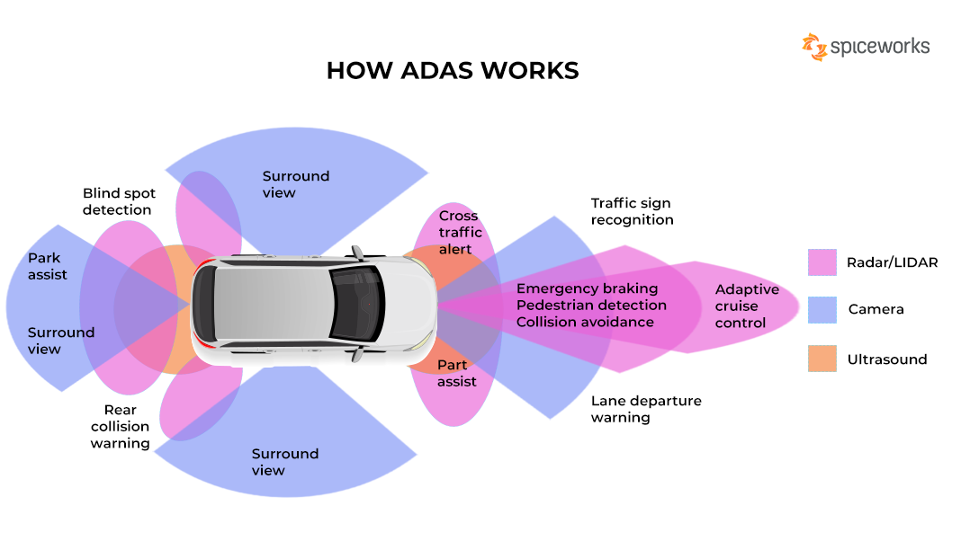
Advanced ADAS Functionalities
ADAS Diagram
Overview
Definition: Leverage sophisticated sensor fusion and processing to provide a higher degree of automation and intervention in driving tasks
Importance: Significant advancements in driving assistance beyond the basics like blind spot detection or rear-view camera
Enhanced Safety
Improved Driver Assistance
Semi-Autonomous Driving
Notes:
Enhanced Safety: Features like automatic emergency braking with pedestrian detection and intelligent speed assist can significantly reduce accidents and fatalities.
Improved Driver Assistance: Systems like highway driving assist and traffic jam assist can automate repetitive tasks and reduce driver workload on long journeys.
Semi-Autonomous Driving Capabilities: Advanced ADAS features pave the way for the future of autonomous vehicl
es by providing a foundation for hands-free driving under specific conditions.
ADAS Features: Automated Emergency Braking (AEB): A system that automatically applies brakes to avoid a collision with a detected object in the forward path. Advanced AEB can include pedestrian and cyclist detection.
Adaptive Cruise Control (ACC): Maintains a set cruising speed while automatically adjusting the car's speed to maintain a safe distance from the vehicle in front.
Lane Centering Assist (LCA): Helps keep the vehicle centered within its lane by providing steering assistance or warnings when drifting.
Highway Driving Assist (HDA): Combines features like ACC and LCA to enable semi-autonomous driving on highways under certain conditions.
Traffic Jam Assist (TJA): Provides automated low-speed following and lane centering in stop-and-go traffic situations.
Parking Assist Systems: Utilize various sensors and cameras to guide the driver during parking maneuvers or even automate the parking process entirely.
Advanced ADAS functionalities are constantly evolving, with new features and capabilities emerging all the time.
It's important to remember that even advanced ADAS systems are not perfect and do not replace the need for an attentive driver. Drivers should always remain engaged and ready to take control of the vehicle.
Regulations around ADAS functionalities can vary depending on the geographical location.
Discussion Points:
How can future ADAS advancements balance automation with driver responsibility to ensure safe and reliable operation?
What infrastructure improvements are necessary to support the widespread adoption of advanced ADAS features?
How can user interfaces be designed to effectively communicate the capabilities and limitations of advanced ADAS to drivers?
References:
National Highway Traffic Safety Administration (NHTSA) - Automated Driving Systems: https://www.nhtsa.gov/vehicle-manufacturers/automated-driving-systems
Society of Automotive Engineers (SAE) Levels of Automated Driving: https://www.sae.org/blog/sae-j3016-update

Slide 5
02 – Integration of AI & ML in ADAS

Slide 6
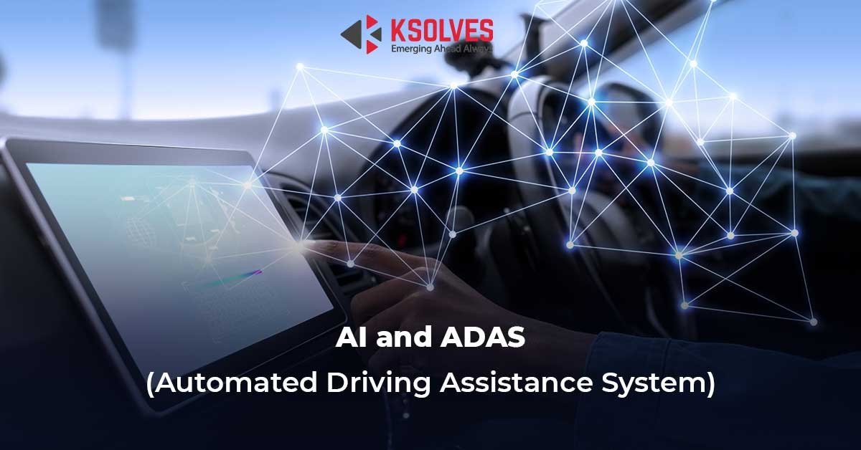
Integration of AI & ML in ADAS
AI and ADAS
Overview
Definition: AI is a branch of computer science focused on creating intelligent machines capable of mimicking human cognitive functions.
Machine Learning: Subfield of AI enables computers to learn and improve from data without explicit programming.
Importance: AI & ML play critical roles in ADAS Advancement
Enhanced Perception & Decision Making
Improved Performance & Adaptability
Foundation for Autonomous Driving
Notes:
Machine learning algorithms process sensor data: Cameras, LiDAR, radar, and other sensors generate massive amounts of data. Machine learning algorithms analyze this data to do the following:
Identify and classify objects (vehicles, pedestrians, traffic signs)
Estimate object distance, size, and speed
Predict object movement and potential hazards
Enhanced perception capabilities: Through machine learning, ADAS systems can:
Track the movement of multiple objects simultaneously.
Perform object detection and recognition with higher accuracy, even in challenging conditions like low light or fog.
Anticipate potential hazards based on object behavior and historical data.
Improved performance and adaptability: Machine learning allows ADAS systems to:
Continuously learn and refine their object detection and recognition models over time.
Adapt to different driving environments and weather conditions.
Personalize ADAS behavior based on driver preferences (following distance in ACC).
Foundation for autonomous driving: The advanced perception, decision-making, and adaptation capabilities fostered by AI and machine learning are crucial building blocks for the future of autonomous vehicles.
Discussion Points:
How can AI and machine learning be leveraged to further improve the safety and reliability of ADAS features?
What are the challenges in ensuring the accuracy and robustness of machine learning models for ADAS applications?
How can we address ethical considerations surrounding driver dependence on AI-powered ADAS functionalities?
References:
A Comprehensive Analysis of AI/ML-enabled Predictive Maintenance for ADAS Systems: https://www.researchgate.net/publication/372444425_Integrated_artificial_intelligence_and_predictive_maintenance_of_electric_vehicle_components_with_optical_and_quantum_enhancements
Machine Learning And Advanced Driver Assistance Systems (ADAS): Revolutionizing Road Safety: https://medium.com/@dorlecontrols/machine-learning-and-advanced-driver-assistance-systems-adas-revolutionizing-road-safety-4edf6eb1718a

Slide 7
03 – Challenges in AI Integration & Performance Optimization

Slide 8
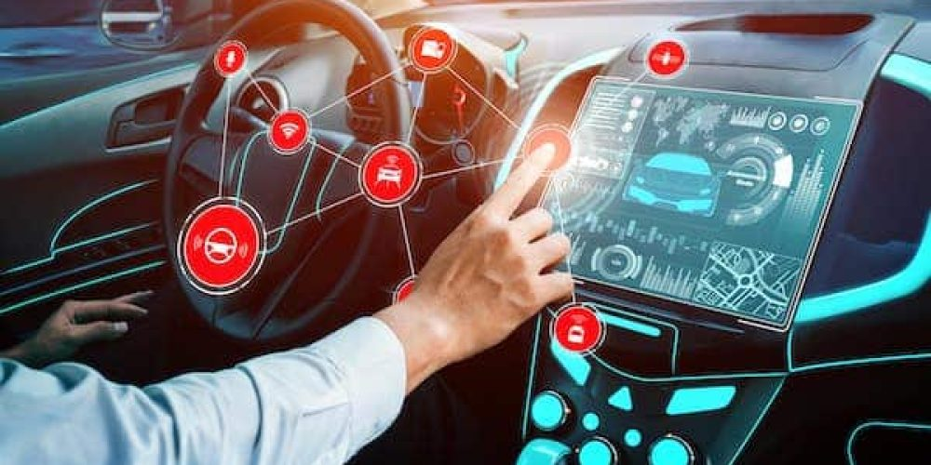
Challenges in AI Integration & Performance Optimization
ADAS Systems
Overview
Definition: AI is a complex process & requires an immense amount of fine-tuning a system to ensure it delivers the best possible results using available resources.
Importance: AI integration is paramount and has significant challenges for successful implementation & optimization
Limited Resources in Vehicles
Real-Time Constraints for ADAS
Data Security & Privacy
Notes:
Limited resources in vehicles: Vehicles have limited processing power, battery life, and thermal management capabilities compared to data centers or personal computers.
Running complex AI models on AAOS can strain these resources, potentially impacting system performance and stability.
Real-time constraints for ADAS: ADAS features like automatic emergency braking or lane departure warning require immediate and accurate responses.
Delays in AI processing due to complex model computations can compromise reaction times and potentially lead to safety risks.
Data security and privacy: ADAS systems collect vast amounts of data from vehicle sensors. This data can include information about the driving environment, driver behavior, and vehicle location
Robust security measures are necessary to safeguard this sensitive data from cyberattacks and ensure it is used responsibly in accordance with privacy regulations.
Performance Optimization Techniques:
Model compression and quantization: Techniques to reduce the size and complexity of AI models, enabling them to run efficiently on resource-constrained hardware.
Edge AI processing: Distributing AI tasks between the cloud and onboard hardware in the vehicle. This can reduce latency and improve real-time performance for critical ADAS functions.
Data anonymization and privacy-preserving techniques: Methods to protect user privacy while still allowing AI models to learn and function effectively from sensor data.
Discussion Points:
How can car manufacturers and tech companies collaborate to optimize AI models for performance and efficiency within the AAOS framework?
What are the trade-offs between accuracy, real-time performance, and resource consumption when implementing AI in AAOS for ADAS?
How can the future development of AAOS address data security and privacy concerns surrounding AI-powered ADAS functionalities?
References:
A Comprehensive Analysis of AI/ML-enabled Predictive Maintenance for ADAS Systems: https://www.researchgate.net/publication/372444425_Integrated_artificial_intelligence_and_predictive_maintenance_of_electric_vehicle_components_with_optical_and_quantum_enhancements
Machine Learning And Advanced Driver Assistance Systems (ADAS): Revolutionizing Road Safety: https://medium.com/@dorlecontrols/machine-learning-and-advanced-driver-assistance-systems-adas-revolutionizing-road-safety-4edf6eb1718a

Slide 9
Thank You!

